Slide 1

Web Scraping
Hong Yang (Jason) Wang

Slide 2
Agenda
Web Scraping
Data
Analysis
Summary
Q&A

Slide 3
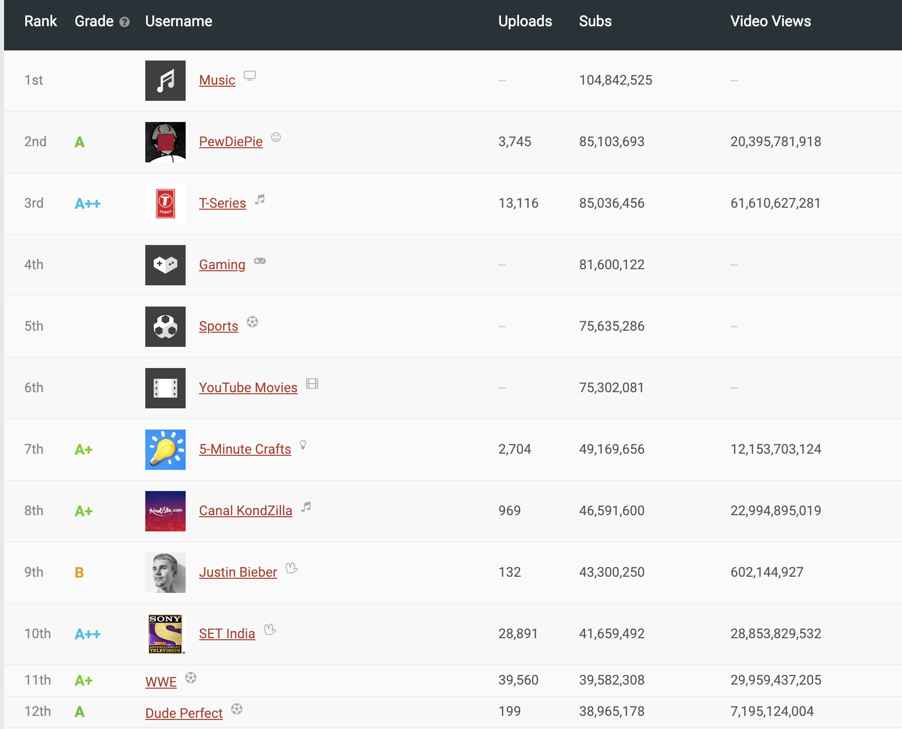
Web Scraping
Socialblade

Slide 4
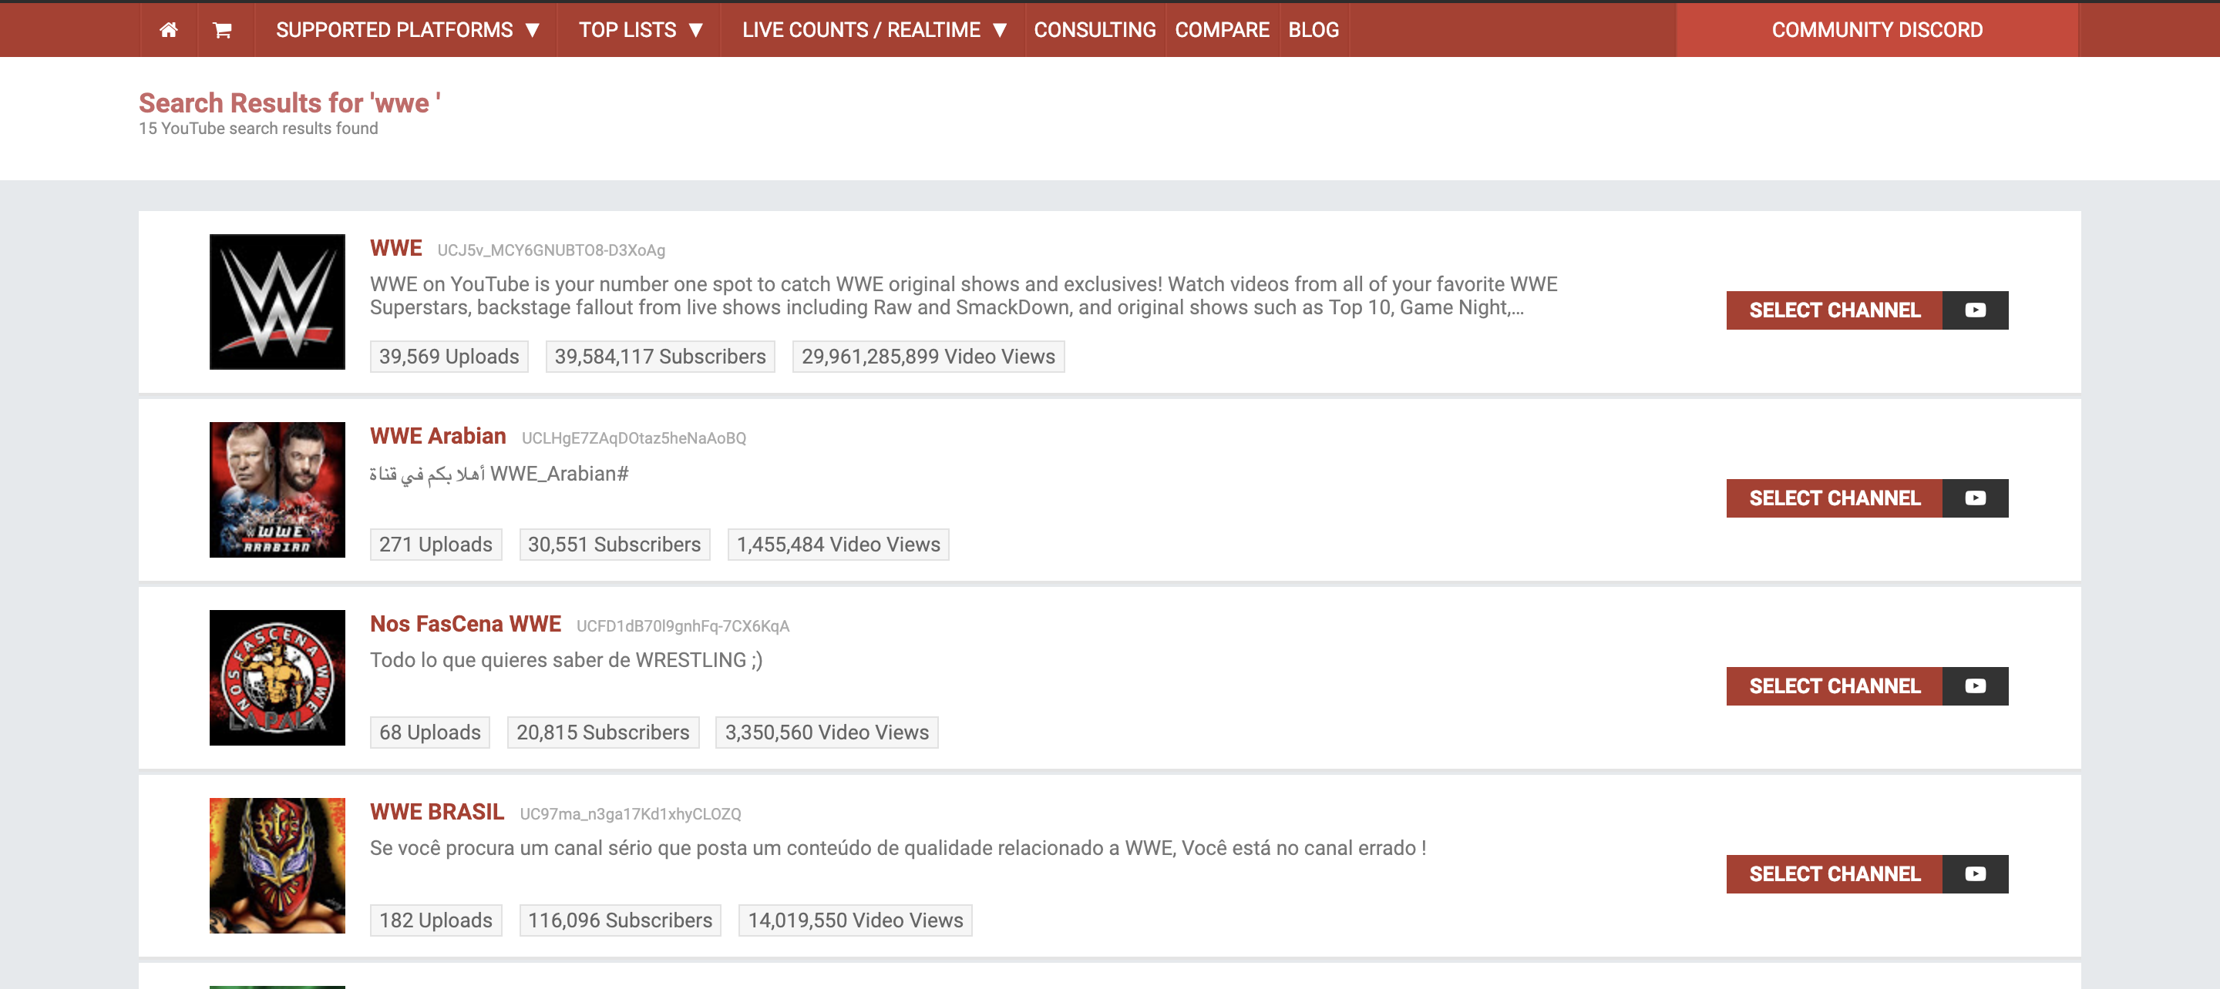
Data

Slide 5
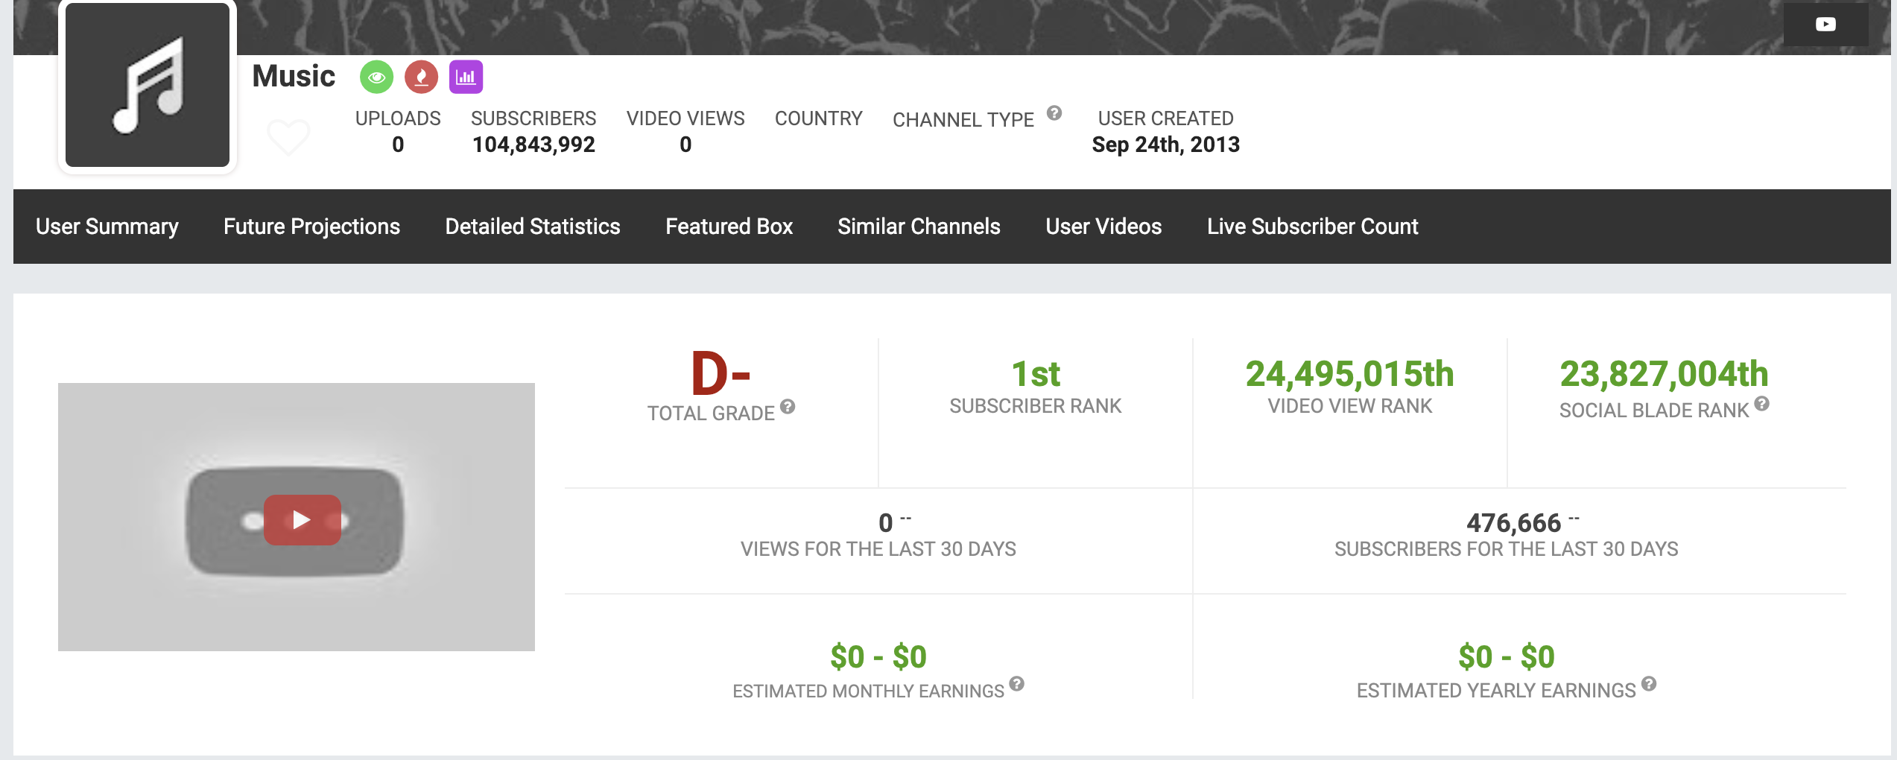
Data (continued)

Slide 6
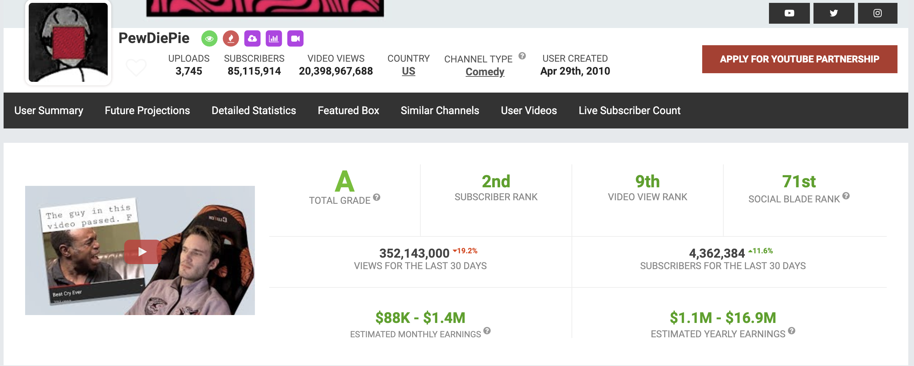
Data (continued)

Slide 7
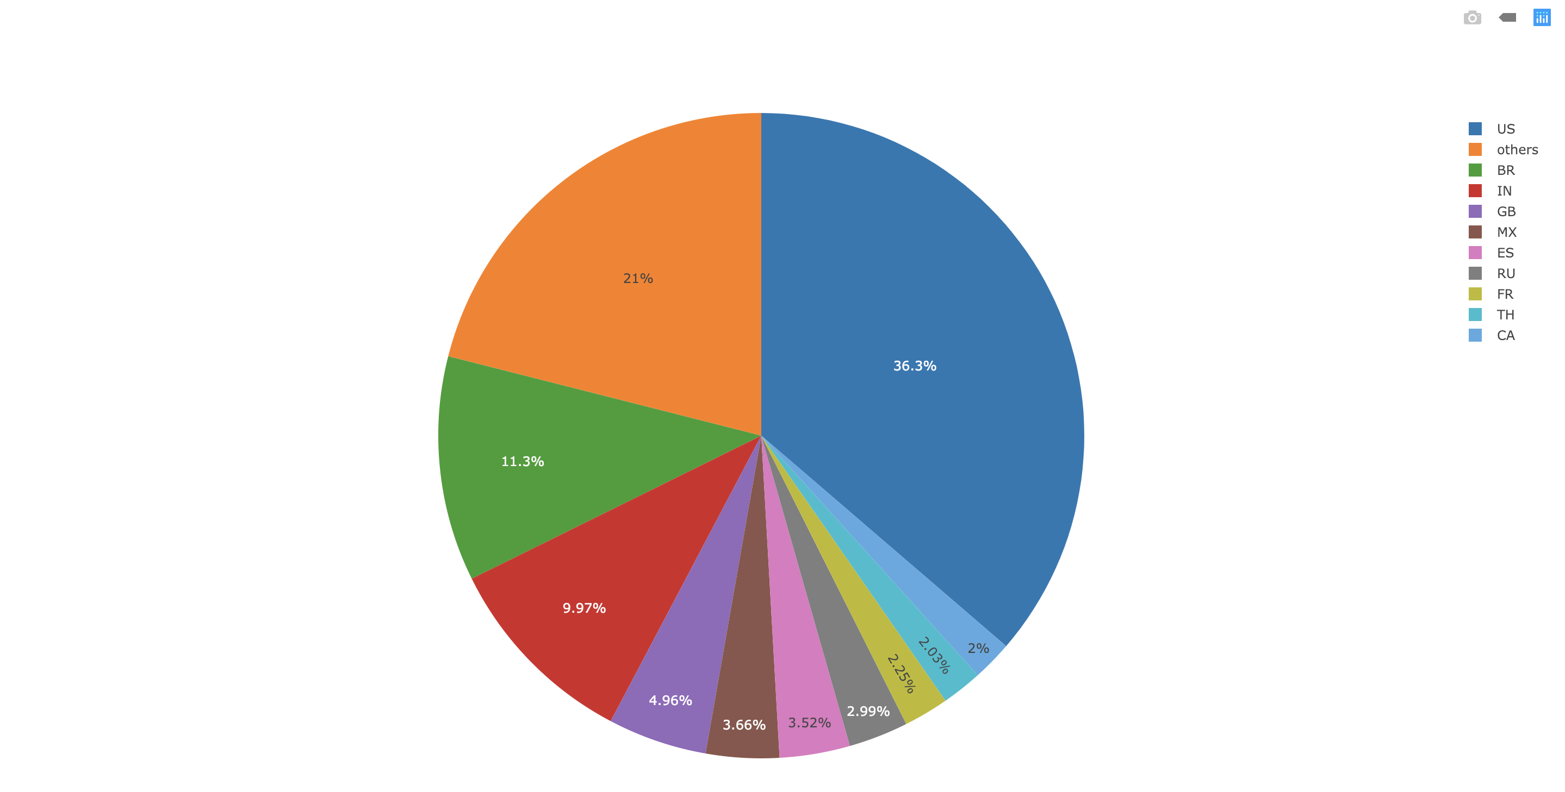
Analysis
Country of Channels
U.S.A.
Other Countries
Brazil
India
United Kingdom
Mexico
Spain
Russia
France
Thailand
Canada

Slide 8
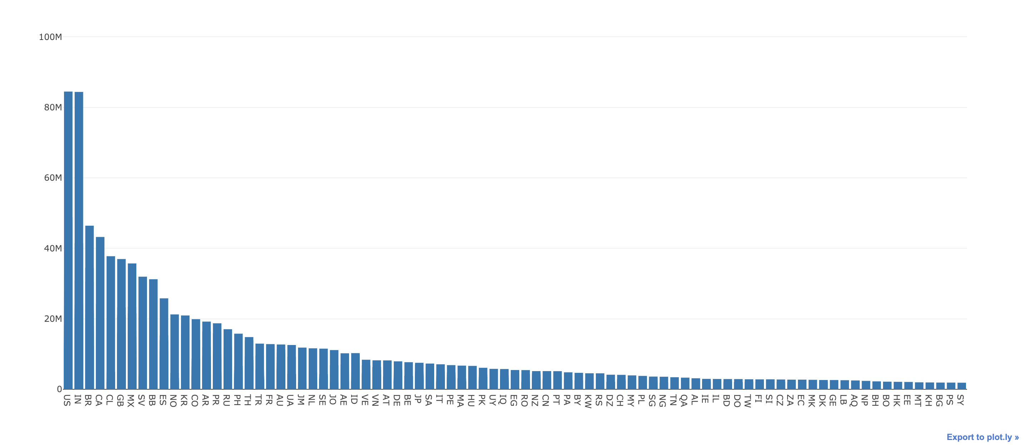
Analysis (continued)
Country-Subscriber
Subscriber
Country

Slide 9
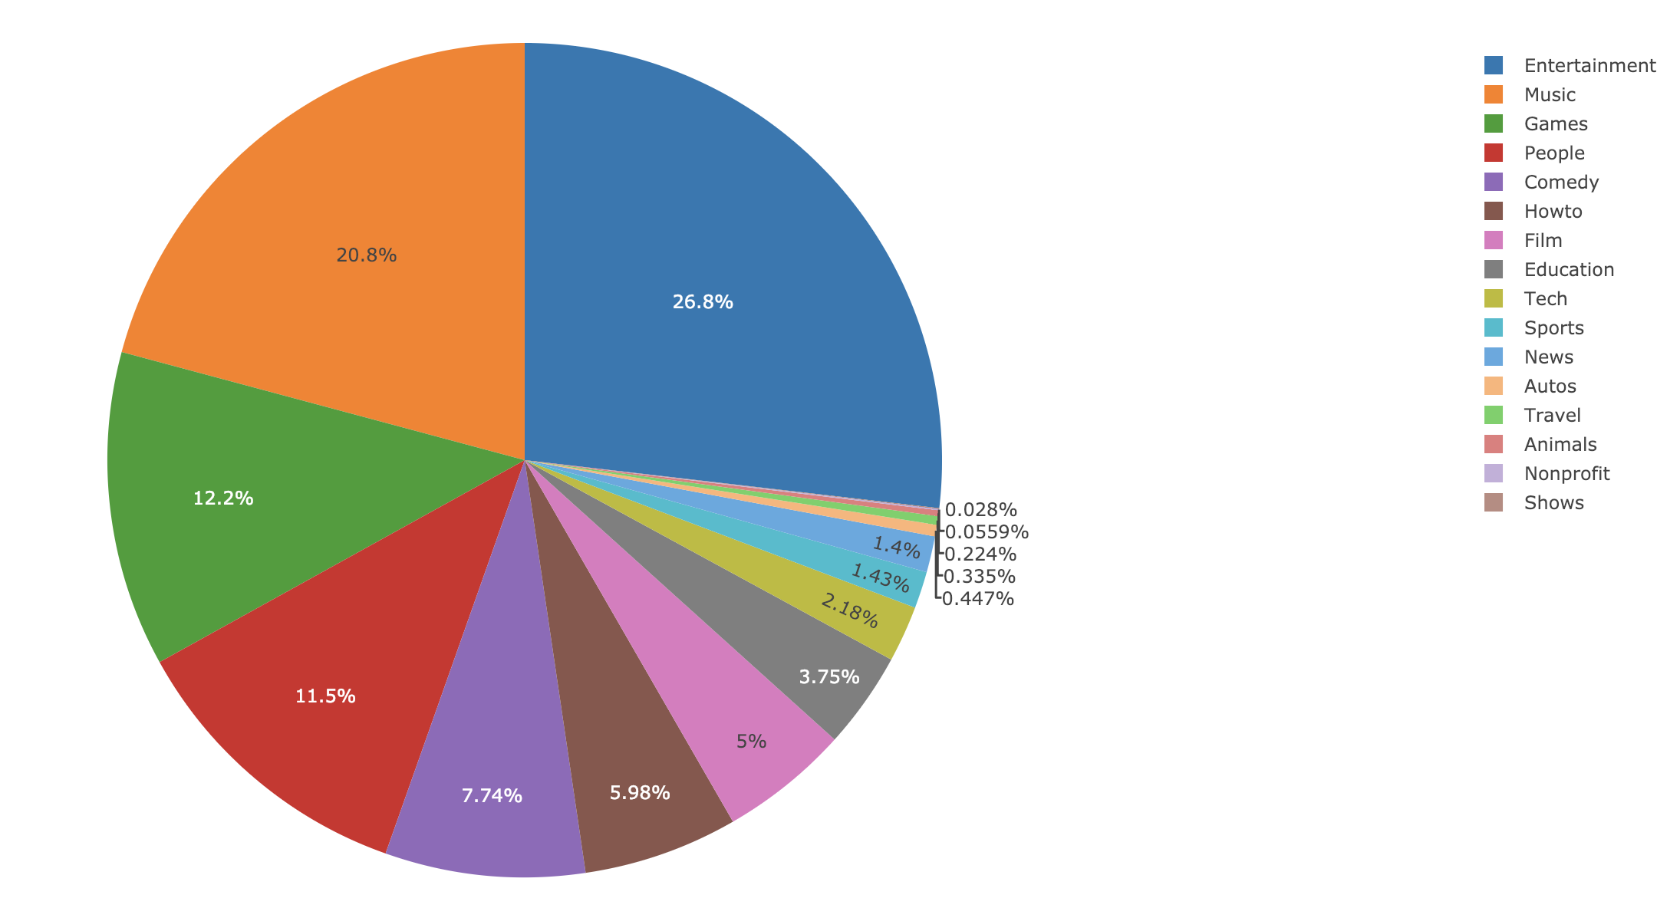
Analysis (continued)
Type of Channels

Slide 10
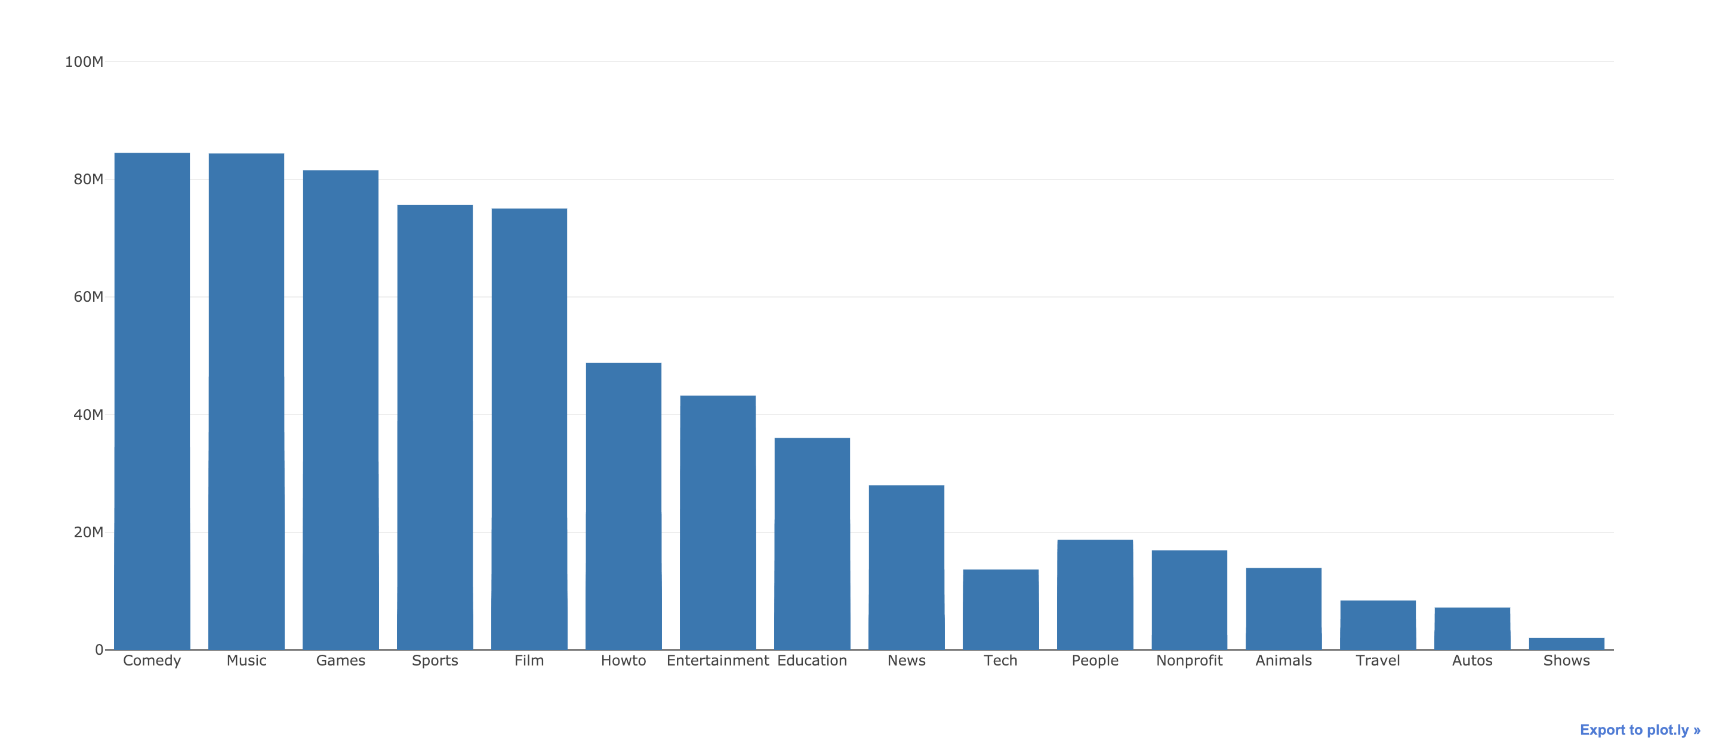
Analysis (continued)
Type-Subscriber
Subscriber
Type

Slide 11
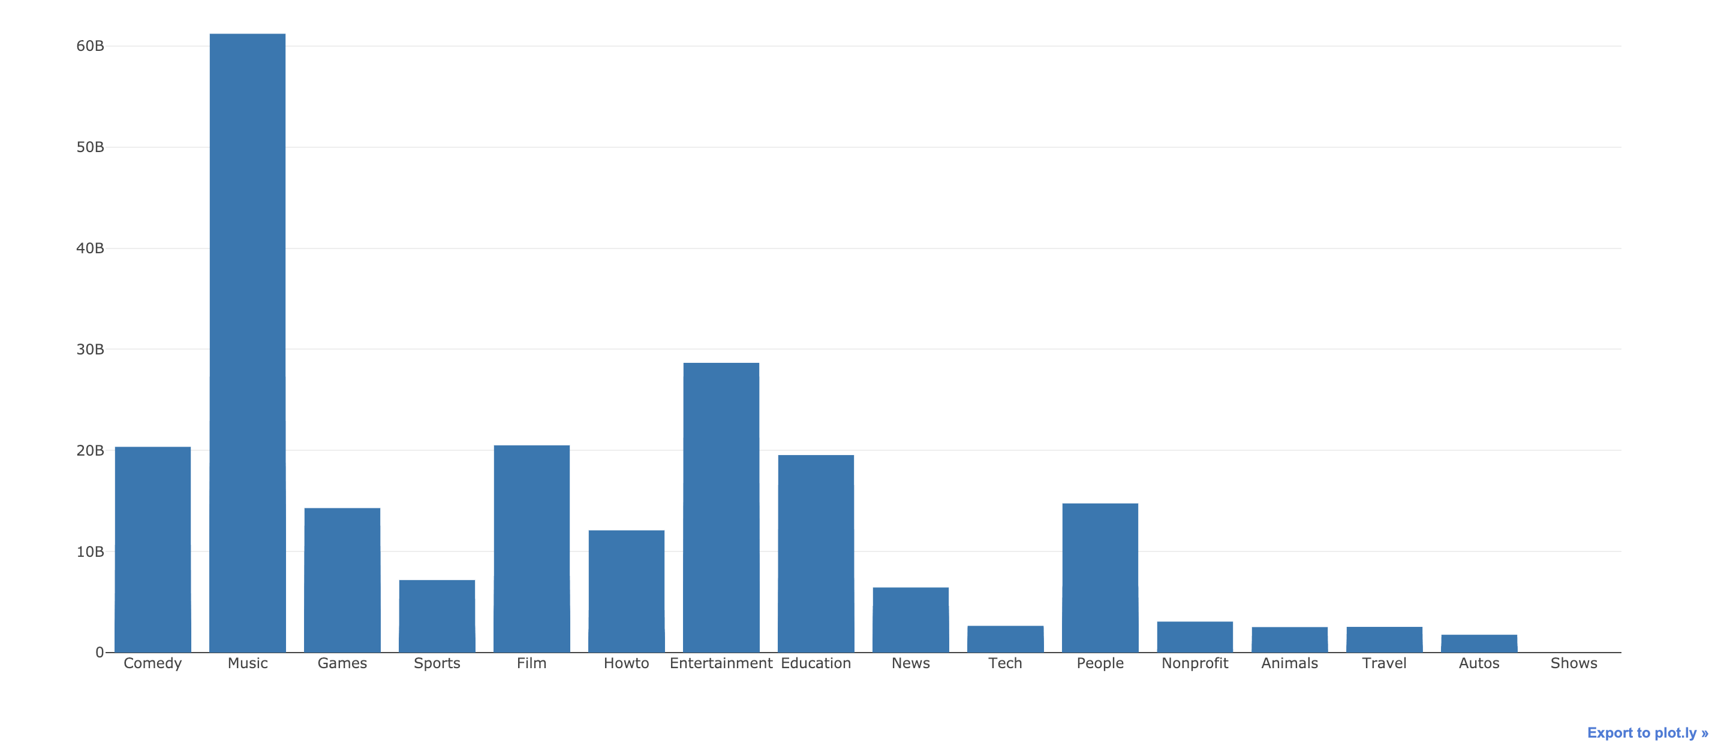
Analysis (continued)
Type-View
View
Type

Slide 12
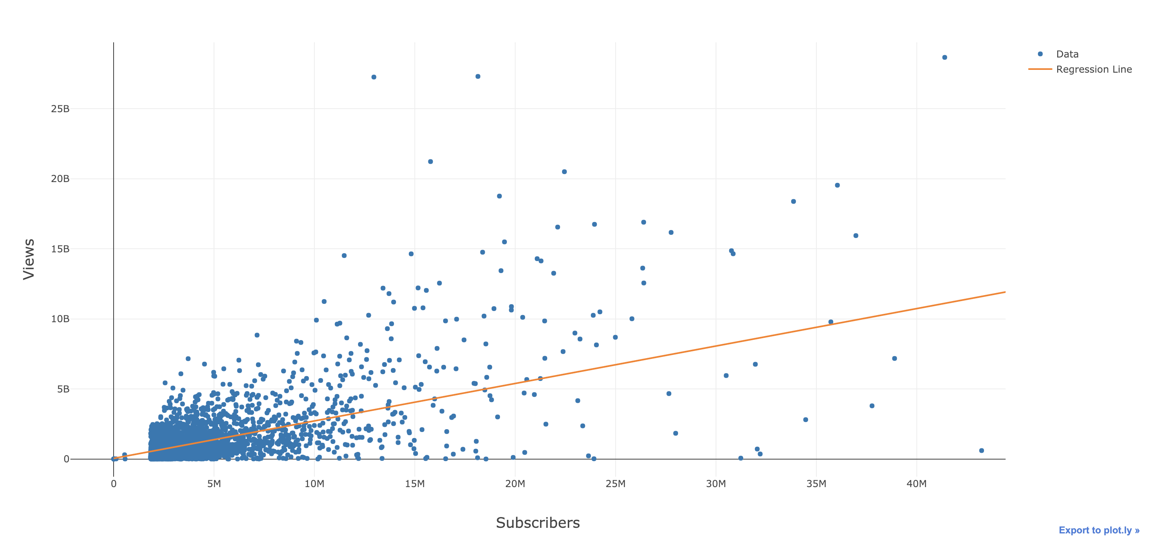
Analysis (continued)
Subscriber-View

Slide 13
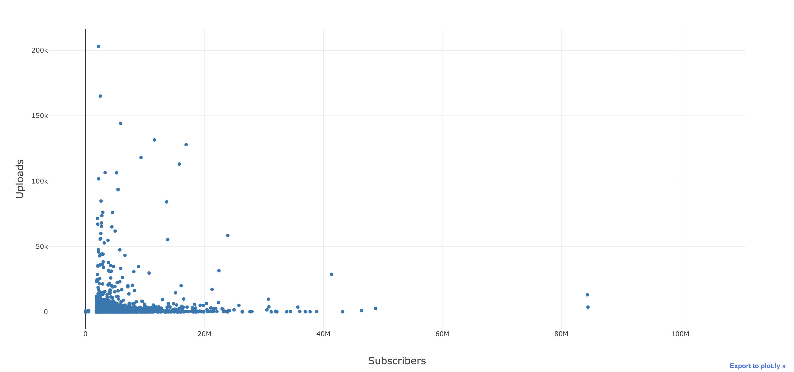
Analysis (continued)
Subscriber-Upload

Slide 14
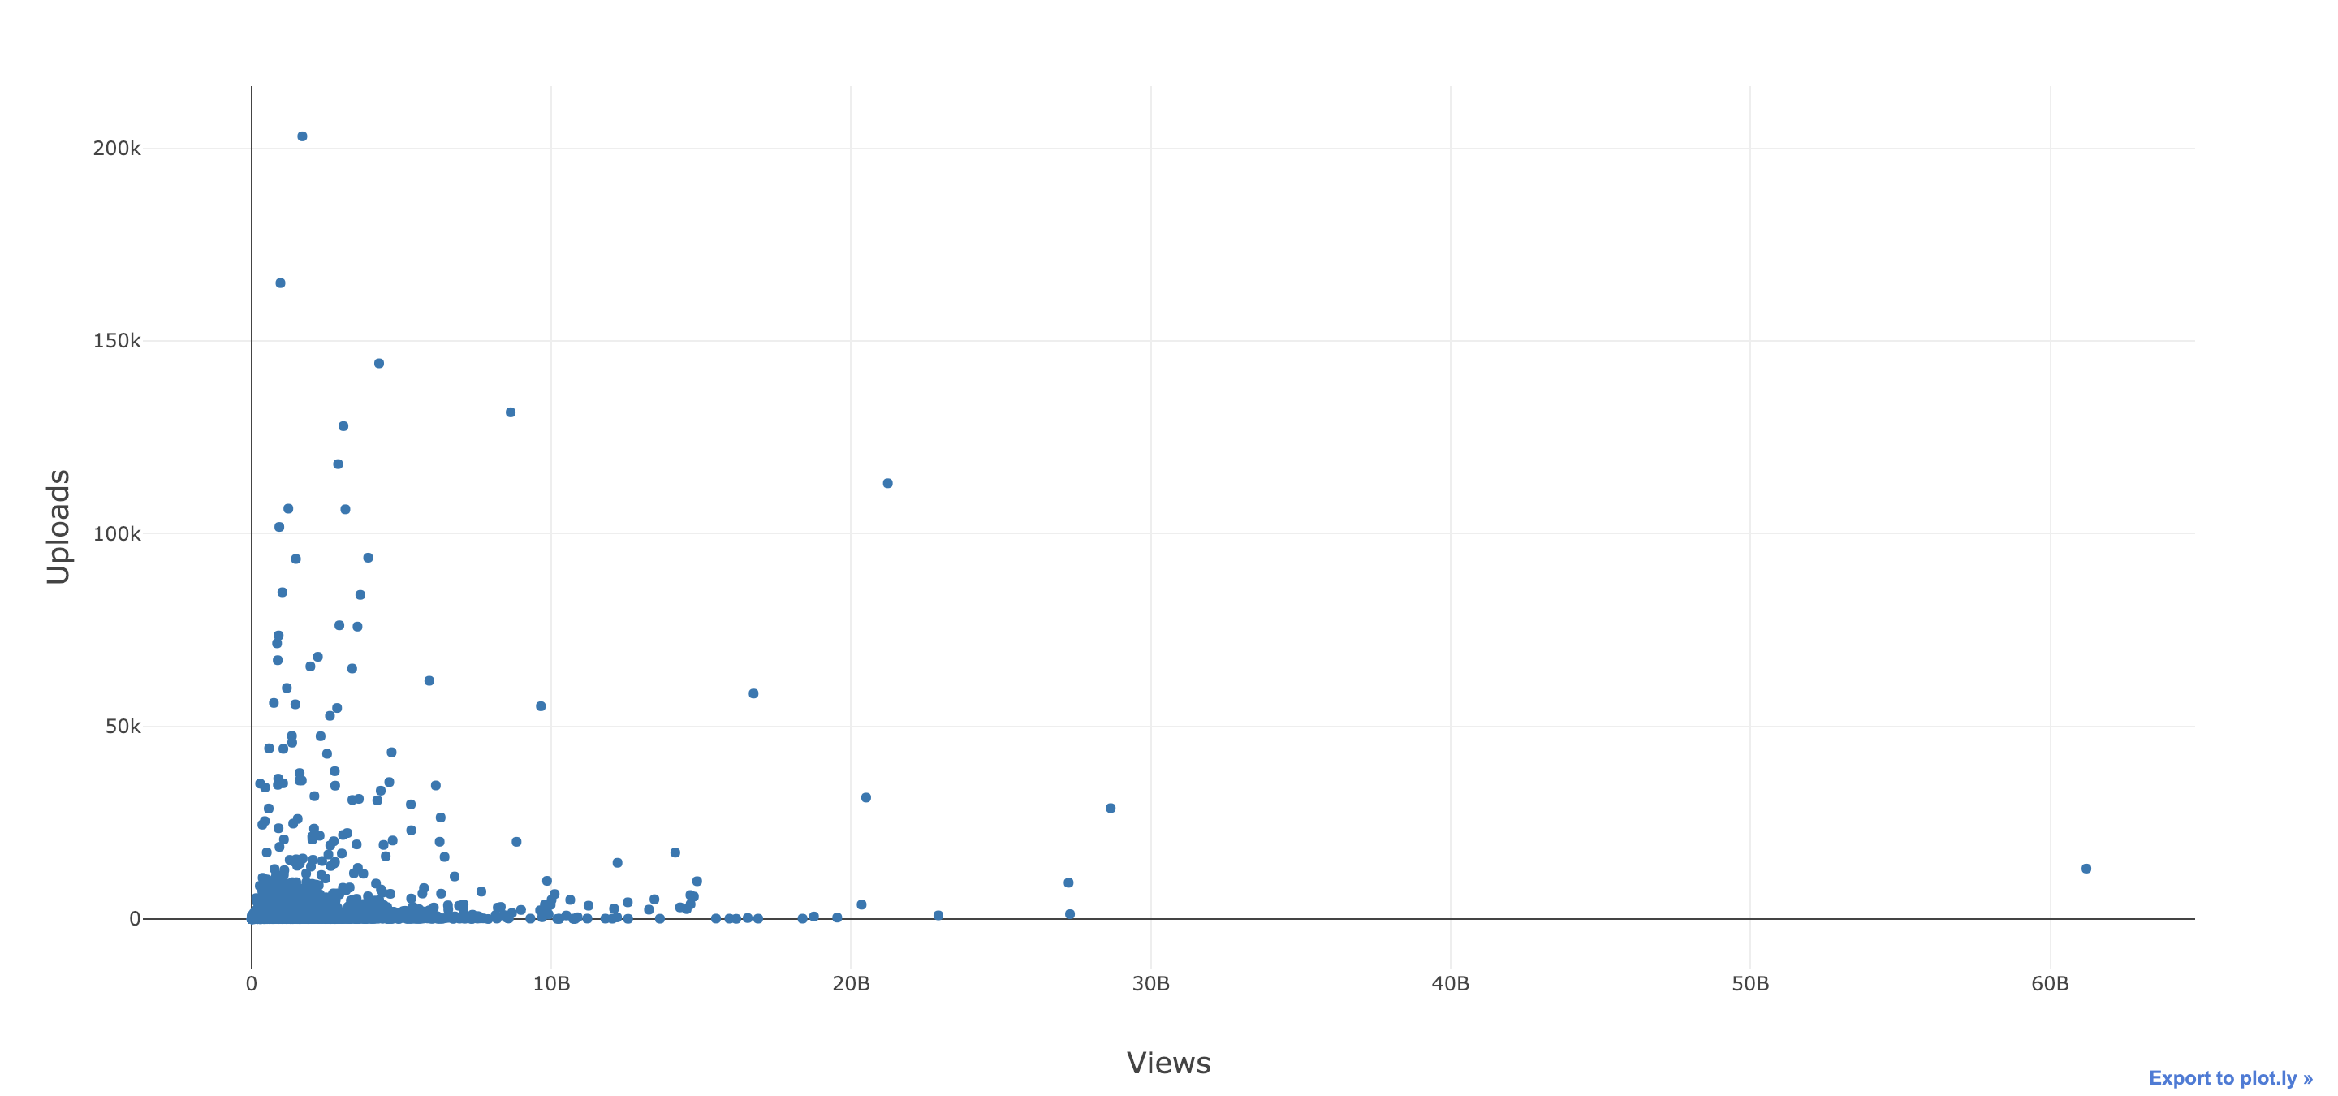
Analysis (continued)
View-Upload

Slide 15
Summary
U.S. and India channel have the most subscribers
Comedy and Music channel have the most subscribers. However, Music has the most views
The more subscriber channels have the more view they will get
Channels with more video upload, have less subscriber and view

Slide 16

Q&A

Slide 17
Credit
https://socialblade.com
pptTemplate.net

